Slide 1
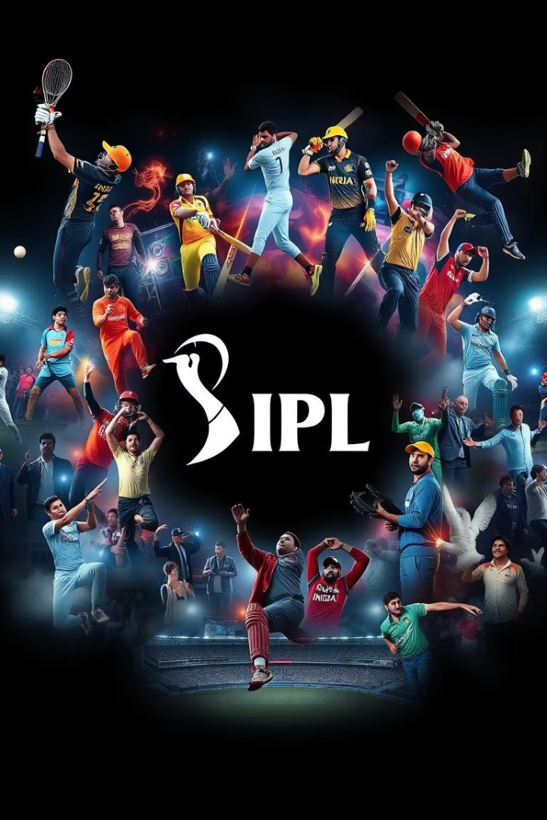

IPL Stats Analysis 2008-2022
The Indian Premier League (IPL) has evolved into one of the most popular and competitive T20 cricket leagues globally. This analysis explores key statistical trends from the 2008 season to 2022, highlighting the evolution of the game, the impact of key players, and emerging trends.
by NAVEEN KUMAR

Slide 2

Introduction: Overview of the IPL
1
Premier T20 League
2
Global Recognition
The IPL is a professional T20 cricket league featuring eight teams representing different Indian cities.
The IPL has gained immense popularity both in India and internationally, attracting top players from around the world.
3
High-Stakes Competition
The tournament is known for its intense competition, high-scoring matches, and thrilling finishes.

Slide 3

Batting Records: Highest runs, highest averages, most centuries
Category
Record Holder
Value
Most Runs
Virat Kohli
6624
Highest Average
Virat Kohli
50.82
Most Centuries
Chris Gayle
6

Slide 4
Bowling Records: Most wickets, best bowling figures, best economy rates
Most Wickets
Best Bowling Figures
Best Economy Rates
Dwayne Bravo
Alzarri Joseph (6/12)
Rashid Khan
Lasith Malinga
Sohail Tanvir (6/14)
Sunil Narine
Amit Mishra
Anil Kumble (5/5)
Imran Tahir

Slide 5

Fielding Records: Most catches, most run-outs, most dismissals
Most Catches
Most Run-Outs
Most Dismissals
Dinesh Karthik holds the record for most catches, demonstrating his exceptional fielding abilities.
MS Dhoni is known for his lightning-fast stumpings and run-outs, contributing significantly to his team's success.
Dwayne Bravo's all-round skills have earned him a place among the players with the most dismissals.

Slide 6

Team Performance: Wins, losses, playoff appearances
Mumbai Indians
1
Mumbai Indians have won the IPL title five times, dominating the tournament with consistent performances.
2
Chennai Super Kings
Chennai Super Kings have won the IPL title four times, known for their strong leadership and experienced players.
Kolkata Knight Riders
3
Kolkata Knight Riders have won the IPL title twice, demonstrating a strong team spirit and strategic gameplay.

Slide 7




Impact of Player Trades and Acquisitions
Strategic Acquisitions
Teams have used player trades to strengthen their squad, acquiring key players in specific roles to fill gaps.
Impact on Team Dynamics
The addition of experienced players often brings in new ideas and strategies, influencing the overall team performance.
Performance Boost
Strategic trades have often resulted in a significant boost in team performance, leading to improved winning records and playoff appearances.

Slide 8




Emerging Trends: T20 strategy, rise of young talent
Innovative Strategies
Teams are constantly experimenting with new strategies and tactics to gain an edge in the fast-paced T20 format.
Rise of Young Talent
The IPL has become a platform for young players to showcase their skills and emerge as future stars.
Evolution of the Game
The IPL has played a significant role in shaping the evolution of T20 cricket, influencing global trends and strategies.

Slide 9

Conclusion: Key Insights and Future Outlook
The IPL has witnessed a remarkable journey, showcasing the evolution of T20 cricket and establishing itself as a global phenomenon. The future of the IPL holds immense potential with the continuous emergence of new talent and exciting new innovations.

